Slide 1
How to Guide

Slide 2
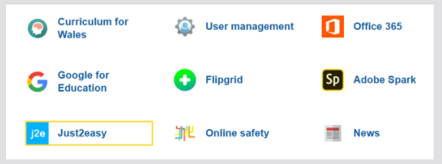
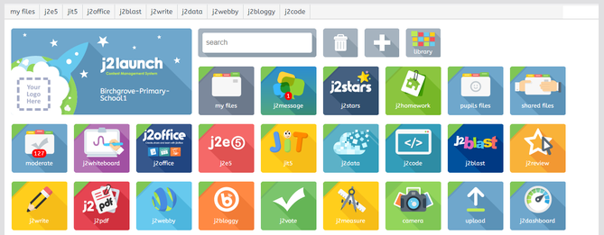

Slide 4
Redo
New
Load
Undo
Save
Print
Publish

Slide 5
Cut
Paste
Copy

Slide 6
Pictures
Shapes
Word List
Measure Tools

Slide 7
New Form
Chart
Video
Table

Slide 8
Cursor
Text
Free Draw
Draw Straight Lines
Draw Rectangles
Draw Squares
Draw Ovals
Draw Circles
These two are continuous lines and swirls.
Remember to double click cursor when finished.

Slide 9
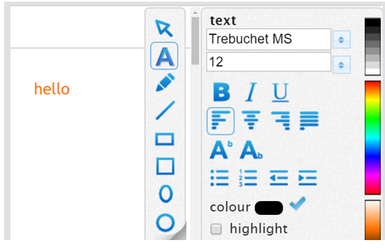

Slide 10
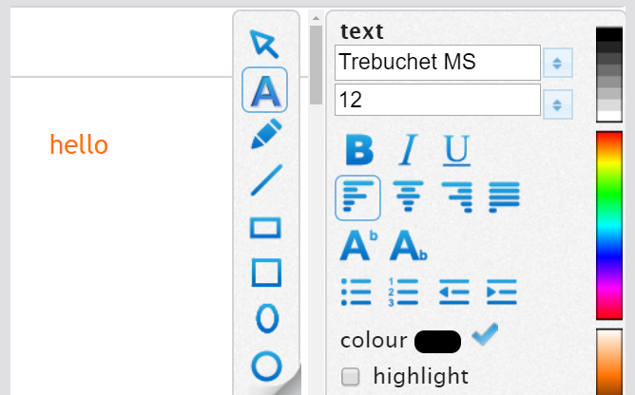

Slide 11
Shared
Pictures
From the web
My Pictures
Upload File

Slide 12
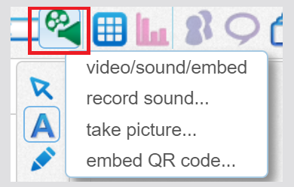

Slide 13
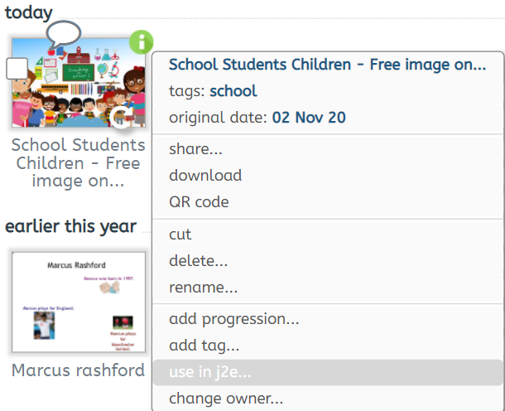
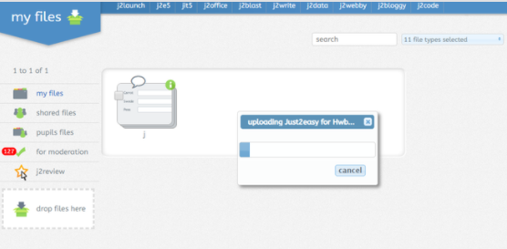

Slide 14
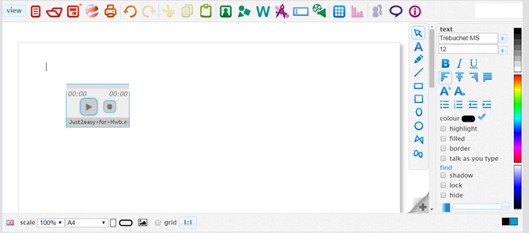

Slide 15
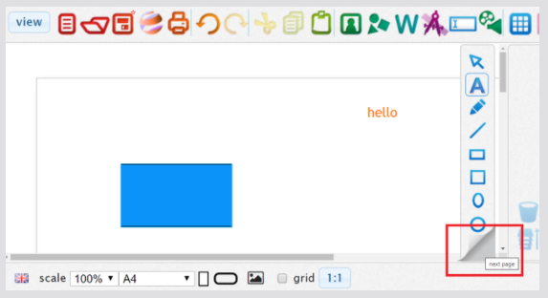
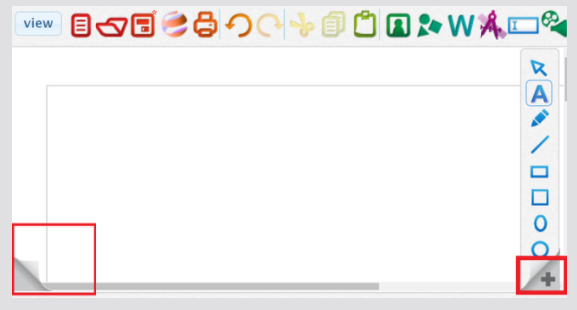

Slide 16
Rename your work with your name then the activity

